Slide 1
Statistics + Economics = Econometrics
Fintech society
Oliver De Fusco

Slide 2
Python is just the tool
Econometrics is the analysis of Economies using data and statistical techniques.
Using statistical techniques we can determine relationships between any two variables.
We can come up with the direct impact of how changing one variable changes another variable
Independent variable and dependent variable

Slide 3
Pandas
To do statistics we need to manipulate data
Pandas is a free open source python library which lets us easily manipulate data.

Slide 4
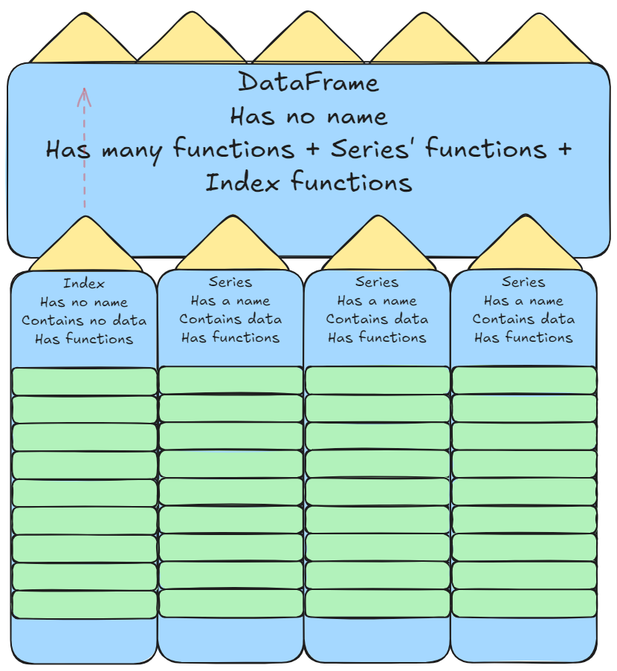

Slide 6
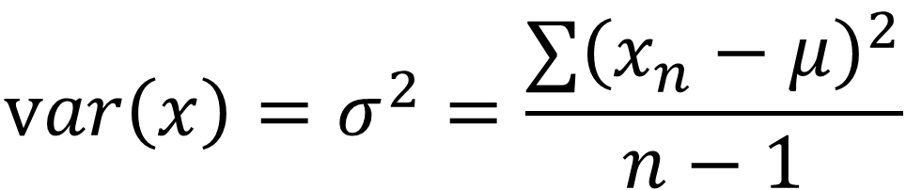
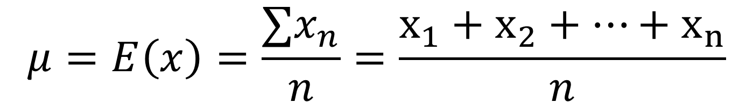
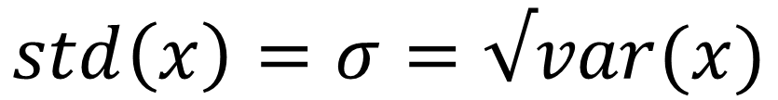
Mean = Average = Expected value
$$μ=E\left(x\right)=\frac{∑x_{n}}{n}=\frac{x_{1}+x_{2}+…+x_{n}}{n}$$
Variance and Standard deviation
$$var\left(x\right)=σ^{2}=\frac{∑{\left(x_{n}−μ\right)}^{2}}{n−1}$$
$$std\left(x\right)=σ=√var(x)$$

